Slide 1
Manly Warringah Football Referees Association
Laws of the Game Changes 2020
Prepared by Hayden Smith
MWFRA Branch Coach

Slide 2
Summary of Law Changes
The introduction of yellow and red cards for misconduct by team officials
A player being substituted leaving the field at the nearest point on the boundary line
At a goal kick and a free kick for the defending team in their own penalty area, the ball is in play as soon the kick is taken (it can be played before it leaves the penalty area)
Other changes include: clearer wording for ‘handball’, attacking team players must be at least 1m away from a defensive ‘wall’, the goalkeeper only has to have one foot on the goal line at a penalty kick, and a new dropped ball procedure (including a dropped ball being awarded if the ball hits a match official and goes into the goal, team possession changes or a promising attack starts).

Slide 3
Dropped ball
Laws 8 & 9
Changes
If play is stopped inside the penalty area, the ball will be dropped for the goalkeeper
If play is stopped outside the penalty area, the ball will be dropped for one player of the team that last touched the ball at the point of the last touch
In all cases, all the other players (of both teams) must be at least 4m away
If the ball touches the referee (or another match official) and goes into the goal, team possession changes or a promising attack starts, a dropped ball is awarded
Explanation
No more contested drop ball, instead the ball will given to the team last in possession, unless the ball is inside the penalty area where it will be given to the goalkeeper
If the ball hits the referee and an advantage is gained it will now be a drop ball

Slide 4
Free kicks
Law 13
Changes
When there is a ‘wall’ of three or more defenders, the attackers are not allowed within 1m of the wall; an attacker less than 1m from the ‘wall’ when the kick is taken will be penalised with an indirect free kick
When the defending team takes a free kick in their own penalty area, the ball is in play once the kick is taken; it does not have to leave the penalty area before it can be played
Explanation
Attackers will no longer be allowed to stand within 1m of a wall of three or more defenders
Source: IFAB Laws of the Game

Slide 5
Goal kick
Law 16
Changes
The ball is in play once the kick is taken; it can be played before leaving the penalty area
Explanation
The ball no longer has to leave the penalty area to be in play. Opponents must still remain outside the penalty area until the ball is in play
Source: IFAB Laws of the Game

Slide 6
Handball
Law 12
Changes
Deliberate handball remains an offence
The following ‘handball’ situations, even if accidental, will be a free kick:
    the ball goes into the goal after touching an attacking player’s hand/arm
    a player gains control/possession of the ball after it has touches their hand/arm and then scores, or creates a goal-scoring opportunity
    the ball touches a player’s hand/arm which has made their body unnaturally bigger
    the ball touches a player’s hand/arm when it is above their shoulder (unless the player has deliberately played the ball which then touches their hand/arm)
Explanation
Provides greater clarity for when non-deliberate handball is an offence:
    Scoring a goal
    Creates a goal-scoring opportunity
    If their hand/arm has made their body unnaturally bigger
    If their hand/arm is above their shoulder

Slide 7
Goal-Scoring Opportunity
Definition
For there to be a goal-scoring opportunity, the following criteria must be considered:
  Distance between the player and the goal
  General direction of play
  Likelihood of keeping or gaining control of the ball
  Location and number of defenders (typically referred to as ‘last man’)
A goal-scoring opportunity is more likely to eventuate when a player has control of the ball, is very close to (and heading directly towards) goal with few defenders in-between the player and the goal. However, these considerations are broad and should be applied to each event on a case-by-case basis.

Slide 8
Kick-off
Law 8
Changes
The team that wins the toss can now choose to take the kick-off or which goal to attack (previously they only had the choice of which goal to attack)
Explanation
Recent Law changes have made the kick-off more dynamic (e.g. a goal can be scored directly from the kick-off) so captains winning the toss often ask to take the kick-off

Slide 9
Penalty kick
Law 14
Changes
The team’s penalty taker can have (quick) treatment/assessment and then take the kick
The goalkeeper must not be touching the goalposts/crossbar/nets; they must not be moving
The goalkeeper must have at least part of one foot on/in line with the goal line when the kick is taken; cannot stand behind the line
Explanation
The penalty kick is not to be taken if the goalkeeper is touching the goalposts, crossbar or net, or if they are moving e.g. the goalkeeper has kicked/shaken them
Goalkeepers now only need to have one foot on the goal line when the kick is taken

Slide 10
Substitutes
Law 3
Changes
A player who is being substituted must leave the field by the nearest point on the touchline/goal line (unless the referee indicates the player can leave quickly/ immediately at the halfway line or a different point because of safety, injury etc.)
Explanation
Substitutes must now leave the field at the nearest point to avoid time wasting. They must go immediately to the technical area after leaving the field

Slide 11
Team officials
Laws 5 & 12
Changes
A team official guilty of misconduct will be shown a YC (caution) or RC (sending off); if the offender cannot be identified, the senior coach who is in the technical area at the time will receive the YC/RC
Explanation
Team officials can now be shown a Yellow Card or Red Card

Slide 12
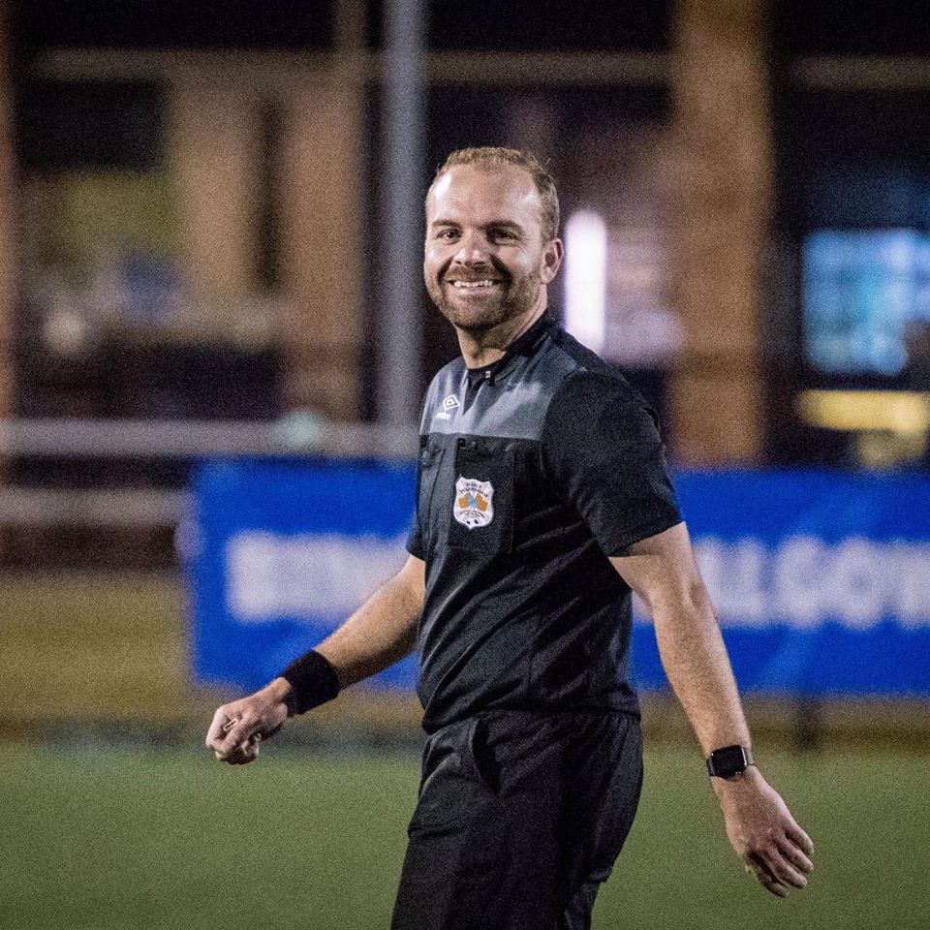
For Laws of the Game enquiries or interpretations please contact:
Hayden Smith – Branch Coach
branchcoach@mwfra.org.au
0406 533 147

